Slide 1
Building a Communication Plan that is Functional for Children that are Nonverbal or Emergent Verbal
Lesley E. Fontana. M.A., CCC-SLP
October 21, 2020

Slide 2
Topic
Development of a quality communication plan that is functional with ways to foster collaboration from multiple parties.

Slide 3
Questions from Concerned Parents
Who initiates a communication plan? Who creates a communication plan? What is its purpose? What are the components? When does a parent ask for one? How does one know whether their child could benefit from a communication plan that is functional?

Slide 4
A Functional Communication Plan : What is it?
Not a formal term nor a legal document. This is best practice in programming for a child with limited communication skills.
A Plan that crosses settings (school, home, community).
A Plan that requires an interdisciplinary collaborative model
A Plan that is functional and naturalistic.
A Plan that allows for practice throughout the day.
A Plan that is measurable and requires consistent progress monitoring.
A Plan that is changed over time as the child masters their goals.

Slide 5
The purpose of a collaborative communication plan that is functional is to provide a measurable way to generalize skills to all settings.

Slide 6
Terminology
Don’t get stuck in the terminology!
Public Schools: Individualized Education Plan (IEP)
Early Intervention: Individualized Family Service Plan (IFSP)
Outpatient/Hospital/Clinic/Private Practice: Plan of Care (POC), Individual Treatment Plan (ITP)

Slide 7
The SLP’s Role
Determines what mode/method of functional communication is most appropriate for an individual.
Establishes appropriate expectations regarding speech and language development.
Specializes in communication sciences from birth to the end of life.
Initiates a communication plan that is functional with the family and the team.
Building a Communication Plan that is Functional

Slide 8
The OT’s Role
Evaluates fine motor, visual-motor integration, and motor planning strengths and weaknesses.
Determines how these affect the child’s ability to access a specific communication system.
Collaborates with the SLP and other service providers to build a communication plan that is functional across settings.
Building a Communication Plan that is Functional

Slide 9
A Team Approach
Interdisciplinary Collaboration: collaborate and communicate for assessment, goal setting, and intervention.
Discuss and share perspectives to identify intervention priorities in building this functional communication plan.
Aim to provide less fragmentation of services.
Building a Communication Plan that is Functional

Slide 10
Infrastructure for the Communication Plan
Information about the Family’s Schedule, the Family’s Communication Priorities, and Environment.
SLP Analysis of Pre-Intentional Behavior, Intentional Behavior, Conventional and Unconventional Communication, Concrete Symbol usage, Abstract Symbol usage, and Language usage throughout the child’s day.
Analysis of speech production skills.
Data from other specialists, including a full Augmentative Alternative Communication Assessment if applicable.
Identification of a system that allows the child to do the following: Refuse (express discontent, protest, refuse or reject), Obtain (request a new action, request more action, request more of an object, make choices, request new objects, request absent objects), Social (requests attention, shows affection, greets people, offers/shares, directs attention, polite social forms), and Gain Information (answers yes/no questions, asks questions, names things/people, makes comments).

Slide 11
Components of a communication plan
A Communication System
Core Vocabulary and Fringe Vocabulary
Natural Aided Language Stimulation (NALS)/Modeling/Partner Augmented Input
Training of All Providers and Caregivers

Slide 12
Training and Implementation of Plan to include:
A written plan for implementing system and fading supports (simple prompt hierarchy)
Written/established in conjunction with SLP/OT and other teaching staff/specialists.
Disseminated along with meeting for review of plan.
Monthly communication between the SLP/OT and teaching staff are very important as the plan is implemented.

Slide 13
Training should include: MODELING for family/staff on how to use the system with the child (best if in person, video can supplement).
OBSERVING family/staff on how to use the system and providing feedback (can be in-person observation or videos or teletherapy).
SLP can provide activities with specific vocabulary targets, using vocabulary in multiple ways.
Top-down Bottom-Up Feedback loop.
Eight-Step Instructional Model (Baud and Senner, 2016)
ParaEducators: Trained in prompt fading, how to provide multiple opportunities for targets across variety of tasks, trained in NALS, trained in concepts of vocabulary being targeted.
Special Education Teacher: Trained as the Lead to collaborate with SLP on functional vocabulary. Works to give feedback to the SLP and assists with paraeducators.
Caregivers (Parents, Nannies, Grandparents, etc.): Trained in prompt fading, how to provide multiple opportunities for targets across variety of tasks, trained in NALS, trained in concepts of vocabulary being targeted.

Slide 14
“To become a proficient user of an augmentative communication system, the child must undergo a substantial portion of his/her training within the many environments in which he/she is expected to communicate. Furthermore, to achieve mastery, the child must be inundated with seeing the system being used frequently, interactively and generatively. In short, to maximize acquisition, augmentative communication training is best conducted with an immersion approach. ”
Learning AAC- Goossens’ (2000)

Slide 15
If a SLP or an AAC Specialist (often a SLP or OT) or Primary Provider (a Special Education Teacher, etc.) has not initiated a plan to assist with generalizing skills across settings, a parent should request help in this area.

Slide 16
Suggestions for Adding Communication Plan Components to a Legal Document (IEP)
“Given that my child is nonverbal or minimally verbal and struggling with communication, I would like these components added to the IEP as a functional evidence-based approach…”
A written plan for targeted vocabulary and how to do it with activities that span across settings could be added to the IEP in Supplementary Aids and Service and Assistive Technology: Use of Communication System, Model naturally occurring and authentic language on device to teach new vocabulary and language, Encourage and capitalize on verbal/vocal communication when student is willing to initiate words, Use of prompt hierarchy.
Example: “Clarify the location and manner in which Supplementary Aids, Services, Program Modifications, and Supports to or on behalf of the student will be provided: Indirect AT services will be provided to include, but are not limited to: repair/replace/updated equipment and software as needed; training for student, staff, and family; ongoing collaboration to support implementation throughout the school day and monitoring student use, parent will be provided with written targeted vocabulary and practice activities.

Slide 17
Ensuring Generalization
Activities of Daily Living!
The most effective way to establish a communication plan is not to make all day feel like therapy or pick 30 minutes to “focus on speech”, but to take the system and start living with it.
Pick what is most motivating to your child and start there! It can appear to be non-functional, but give it communicative intent, add in taking turns, follow their lead, and use the new system to start the action.

Slide 18
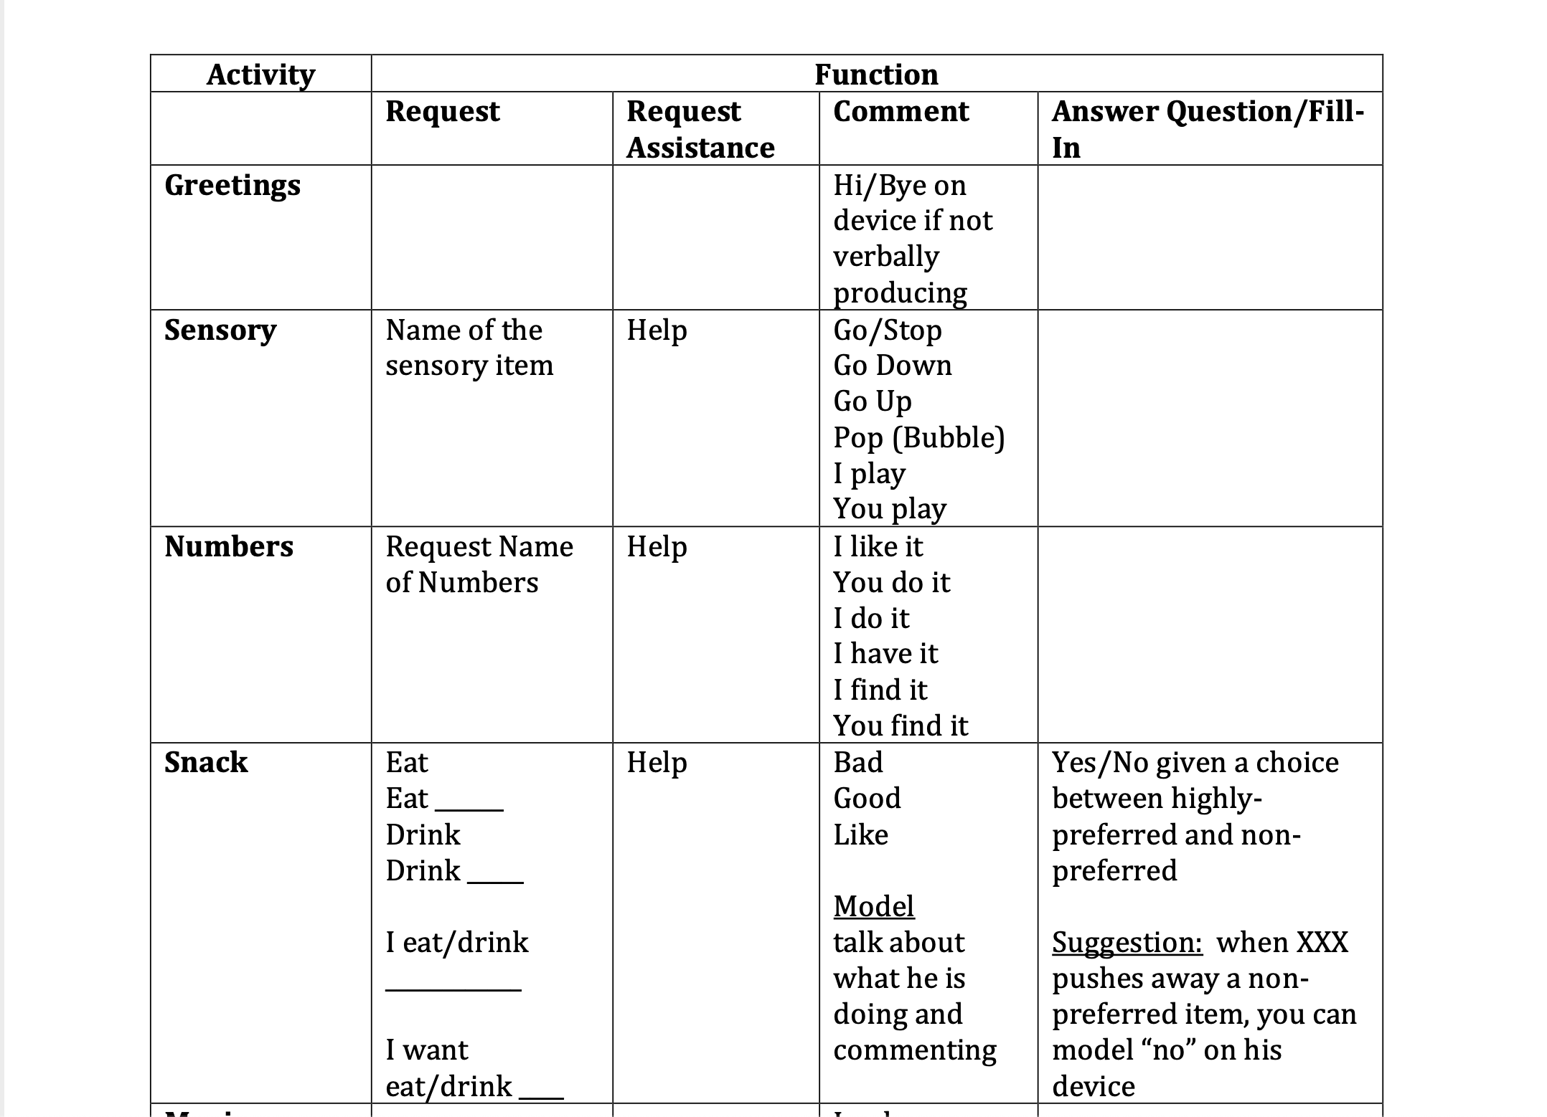

Slide 19
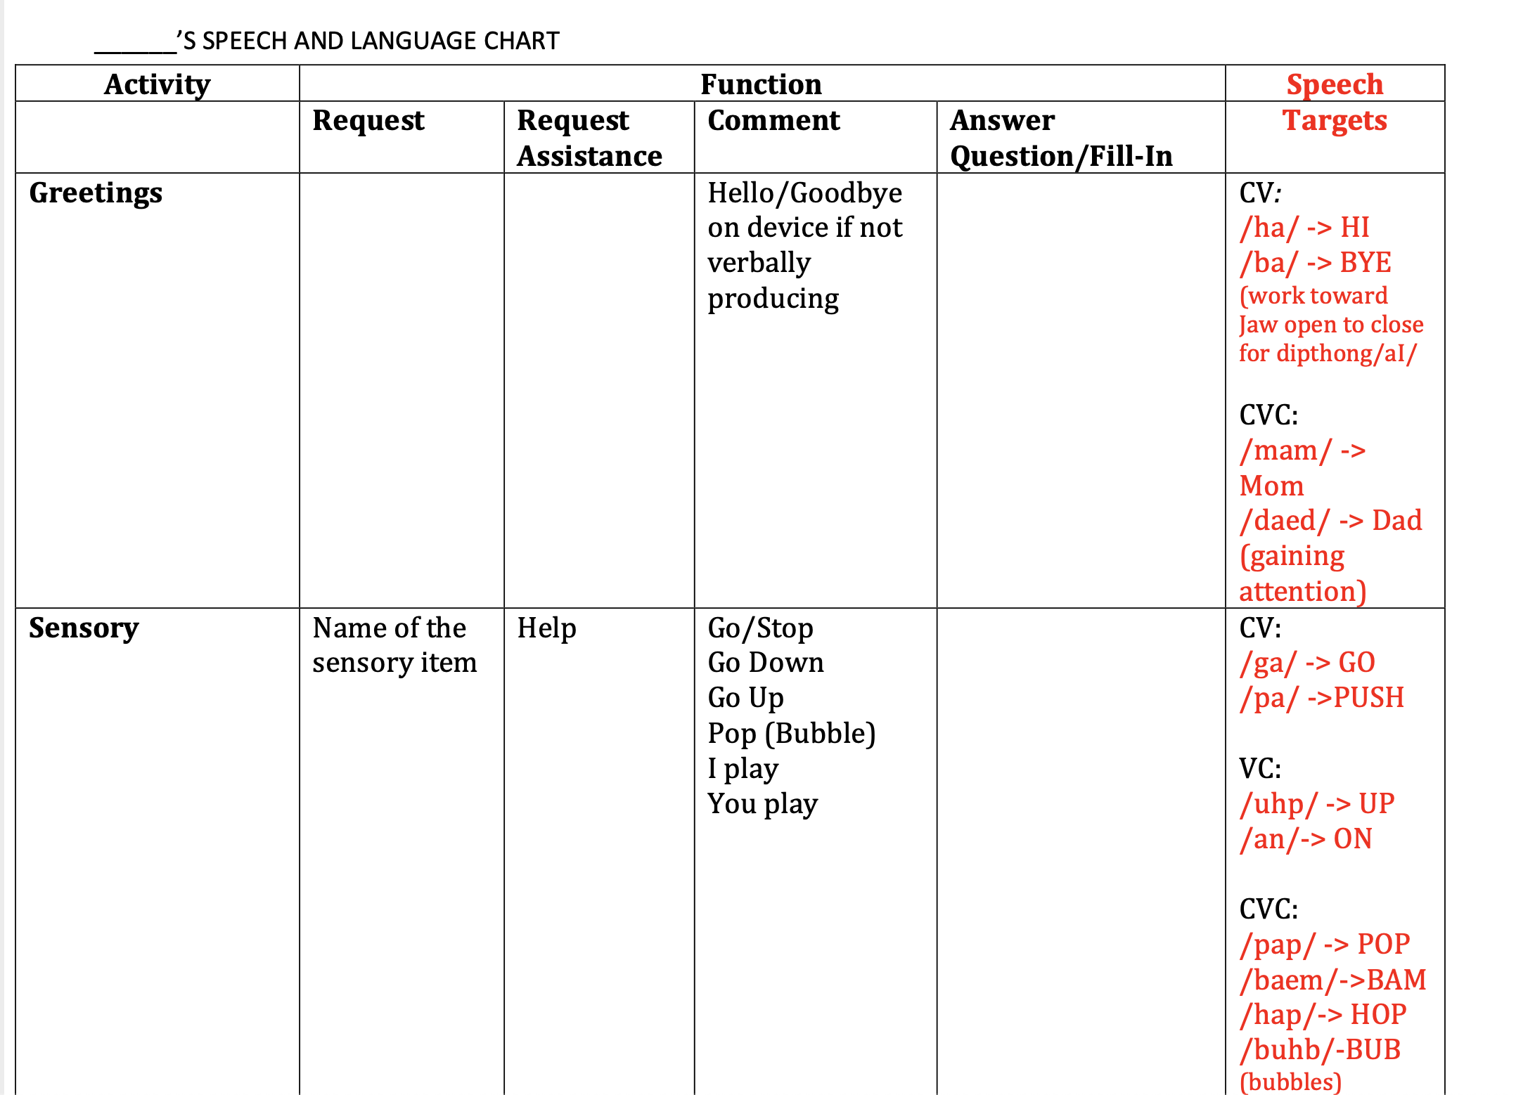

Slide 20
Final Thoughts
Each specialist brings a unique set of skills necessary to implement a communication plan that is both functional and effective.
The role of the Speech-Language Pathologist is to determine what mode/method of functional communication is most appropriate for an individual and establish appropriate expectations regarding speech and language development.
I know this was very basic so if you have any questions, please write to my email at Lesley.fontana@spotofmd.com.
Thank you so much!

