Slide 1
“The Importance of Self Advocacy to Success”

Slide 2
Hello!
Julia Bascom
Autistic Self Advocacy Network (ASAN)
http://autisticadvocacy.org/

Slide 3
ASAN
National self-advocacy organization run by and for autistic adults, speaking for ourselves
Focus on systems change and policy advocacy, focus on adults across the spectrum
Nothing About Us, Without Us

Slide 4
Note about language
Different disability communities have different preferences!
The Autistic community, like the Blind and the Deaf communities, prefers “identity-first” language. (“Autistic person” instead of “person with autism.”)
My autism isn’t like luggage or a roommate or a incidental trait--it’s a big part of who I am, and I own that.

Slide 5
Rethinking disability

Slide 6
Disability 101
Autism is a disability.
Disability is different than you think.
Disability is a natural part of the human experience. It is okay to be disabled.

Slide 7
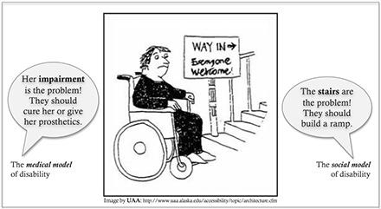
Social model of disability

Slide 8
A disability identity is a passport
Being disabled means I have civil rights.
Being disabled means I have a community.
Both my rights and my community were created for me by people with very significant disabilities.

Slide 9
Rethinking Autism

Slide 10
What do we already know about autism?
It’s a neurodevelopmental disability
It’s a spectrum! Everyone has their own way of being autistic.
Challenges with language, social communication, sensory processing, executive functioning, adaptive behavior, etc….

Slide 11
Rethinking autism
We are very familiar with the impairments!
What happens if we think about strengths and differences, as opposed to deficits?

Slide 12
Rethinking autism
Instead of:
Restricted interests
Stereotypies
Pedantic
Developmental delays
Delayed echolalia
What about:
Deep passion and enthusiasm
“Her body does her happy”
Precise, thoughtful
Different developmental trajectories
Always has a quote!

Slide 13
Rethinking autism
It’s not binary! By definition, all autistic people experience impairment and challenges
But not everything is a deficit. The same sensory difference that makes crowds painful also makes music beautiful.
We are complex. We have strengths.

Slide 14
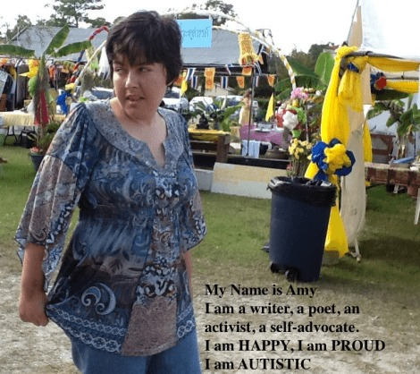
Rethinking autism
Autistic adults exist!
You can be happy and autistic!
You have a right to be happy and autistic!

Slide 15
A note about functioning labels
Functioning labels aren’t helpful. They don’t convey information, and they hurt more than they help.
We are one community. It’s a spectrum, not a scale.
Most importantly: nothing I am saying is dependent on the level of support someone needs.

Slide 16
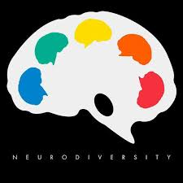
Neurodiversity
Neurological + Diversity = Neurodiversity
There are lots of different ways to have a brain, and that’s good. We can make a world with room for everyone.

Slide 17
What does neurodiversity mean?
Everything we’re talking about here today.
Autism acceptance
Disability rights
Changing our thinking
Inclusion
Self-advocacy

Slide 18
What happens if we transition our thinking?

Slide 19
What happens if we transition our thinking?
We focus on supporting autistic people, instead of normalizing us.
Instead of behavior modification, we focus on communication support, sensory processing, and motor and cognitive skills
Instead of segregated special classes, we focus on making inclusion work for everyone
Instead of rehearsing facial expressions, we focus on acceptance and self-advocacy
Instead of sheltered workshops, group homes, and other ways of segregating autistic adults, we support folks to live the lives we want in the community

Slide 20
What happens if we transition our thinking?
We redefine “success.”
What does success look like?
What does it mean if success, happiness, and autism aren’t incompatible?
Can success include needing a lot of direct support?
Can success include relying on accommodations?
Can success include significant support needs?
What really matters? What do we really want?
How does redefining success help everyone, autistic or not?

Slide 21
What happens if we transition our thinking?
Autistic people are recognized as valued members of our communities:
As students and classmates
As coworkers, employees, and employers
As neighbors and customers
As friends and mentors
As spouses
As parents
As community leaders

Slide 22
Self-Advocacy

Slide 23
What is self-advocacy?
Self-advocacy is about speaking up for yourself and making your preferences and opinions known. It is about being in charge of your life and your future.
It looks different for everyone.
It is the key to having a good life.

Slide 24
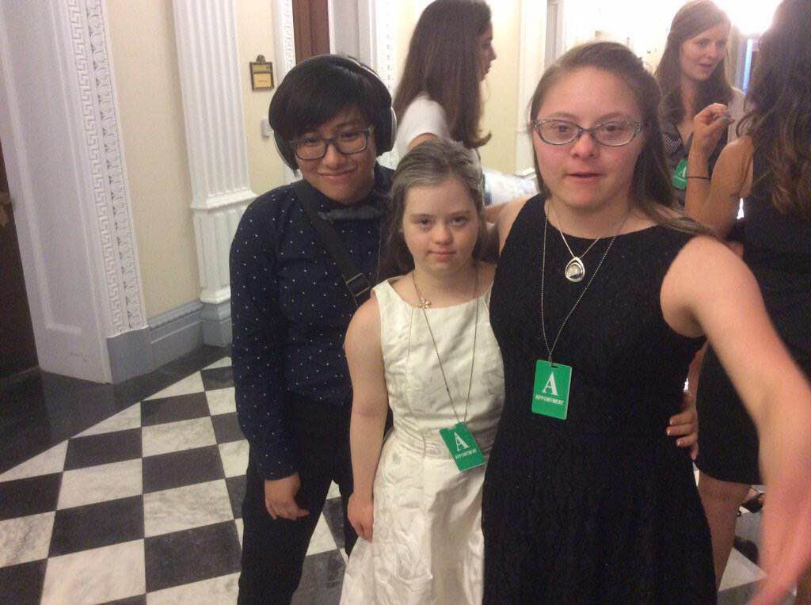
Why is self-advocacy important?
It’s the future.

Slide 25
Different kinds of self-advocacy
Formal advocacy
Self-determination
Eggs for breakfast
No!

Slide 26
Formal advocacy
This is what ASAN does
Advocacy on behalf of your community, not just yourself
Nothing about us, without us!

Slide 27
Self-determination
Setting your own goals
What do I want to do? What do I want to be when I grow up? How do I want to spend my time?
Being in charge of your life

Slide 28
Eggs for breakfast
Making choices
Expressing preferences
Being listened to

Slide 29
No!
Behavior is communication.
Yes, even “challenging behaviors.”
The most important skill someone with a developmental disability can have is the ability to say no.

Slide 30
What ISN’T self-advocacy?
Self-advocacy isn’t linear.
Self-advocacy isn’t all-or-nothing.
Self-advocacy doesn’t come with pre-requisites.

Slide 31
Pre-requisites for self-advocacy
To be a self-advocate you need exactly 2 things:
1: An ability to independently move 1 or more muscles somewhere on your body.
2: Preferences.
That’s it.

Slide 32
Self-advocacy is for everyone, all the time.

Slide 33
Owning it

Slide 34
Why do you need to understand your disability?
You need to understand your disability in order to advocate for yourself effectively.
Understanding your disability doesn’t limit you--it empowers you. It gives you the tools you need to do what you want.
Own it.

Slide 35
Understanding your disability
Your child ultimately needs to understand:
What my disability is, and what it means for me.
What can I do?
What can’t I do?
What do I need help with?
What kind of help do I need?
How do I feel about all of this? What do I want to do with those feelings?

Slide 36
Supporting self-advocacy

Slide 37
Relax
Self-advocacy is a practice, and it looks different for everyone. You don’t have to do everything at once! You can take some time.
Every day gives you hundreds of opportunities, big and small, to practice supporting self-advocacy in your child.
Just keep practicing.

Slide 38
Communication & choices
Communication: does your child have access to an effective method of communication?
How can you support their communication skills?
We make hundreds of choices every day. What choices does your child make now? What about typical kids? How can you expand that?

Slide 39
Rethink “behavior”
What is this behavior telling me?
How can I support my child in their self-advocacy?
How can I help them self-advocate more effectively?

Slide 40
Who is this for?
Think carefully about therapies and therapy goals. Who is this for? What is the goal here?
Self-determined adulthood vs indistinguishability
Remember the golden rule.

Slide 41
Presuming competence
With the right supports, everyone can learn, grow, and do more
Everyone is a person, with thoughts and feelings
The least dangerous assumption

Slide 42
Metacognition
Modelling
Goal-setting
Reflecting

Slide 43
The IEP
Nothing about us, without us!
Start small, start early
Explore technology
If you wouldn’t say it with us in the room, don’t say it

Slide 44
Supporting independence
Increasing responsibility
Dignity of risk
Letting go

Slide 45
Tell your child they are autistic
They are already labelled.
It’s their passport to understanding.
It can be a process. That’s normal.

Slide 46
Autistic community
Peer support!
Seek out autistic adults: mentors and possibility models.
Find and tell new stories.

Slide 47
Self-advocacy in schools starts with inclusion
Every school is different, and many of them have inherited histories of inequity
Focus on making sure every child is a valued member of the same school community and classroom
And get the kids involved!

Slide 48
Questions?

